Slide 1

AI Powered assistant for RedHat OpenShift
Shanmugakumar Manoharan

Slide 2
AKS Copilot: AI-powered assistant for Kubernetes
AKS Co-pilot is a tool that helps developers/Platform team to troubleshoot faster and better by using artificial intelligence LLM Models.
It is powered by OpenAI Codex, a deep learning system that can generate natural language and code from natural language.
It works as a OpenShift extension that suggests Platform Team Debugging snippets as the Administration types.
It can also generate YAML code from comments, docstrings, tests, and other natural language inputs.

Slide 3
AI in everything, everywhere, all at once...

Slide 4
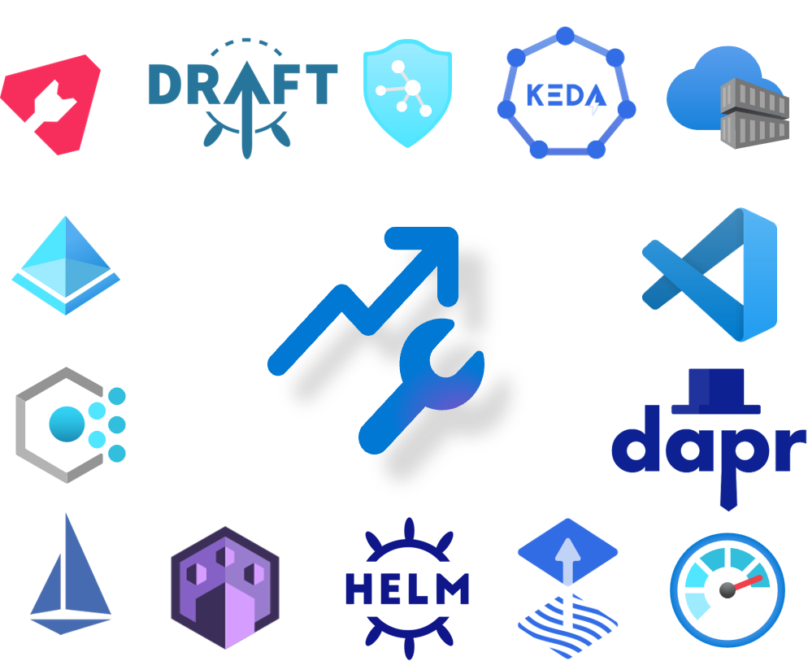



OpenShift - Empowering you to differentiate
The full power of Kubernetes and the open-source ecosystem
A fully managed service to make it simpler and more productive
Guiding & bootstrapping your experience without abstracting
How can OpenShift and AI help you excel and make the most from Kubernetes?

Slide 5

OpenShift Copilot: AI-powered assistant for Kubernetes
Streamline your operations
Reduce your skilling efforts
Empower your developers
Available free for all clusters

Slide 6
Retrieval Augmented Generation
User Question
Workflow
Query My Data
Customized Open AI
Add Results to Prompt
Large Language Model Kubectl Plug-in
Query Model
Send Results

Slide 7
OpenShift Copilot: Core
Integrate OpenShift and Open AI build Intelligent System.
AI Powered Pair platform administration
AI Powered Troubleshooting
AI Powered Reasoning Engine for OpenShift Users
AI Powered Drift Detection

Slide 8
OpenShift Copilot: Use Cases
Trouble shooting the Defective PODS with Pre-Defined Models.
Interactive Pair Programming based on Context

Slide 9
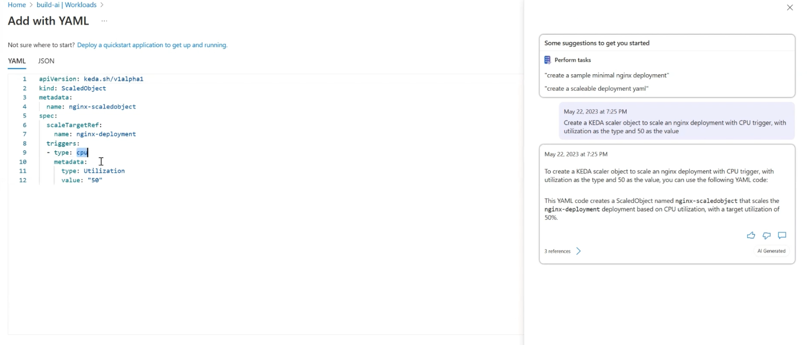
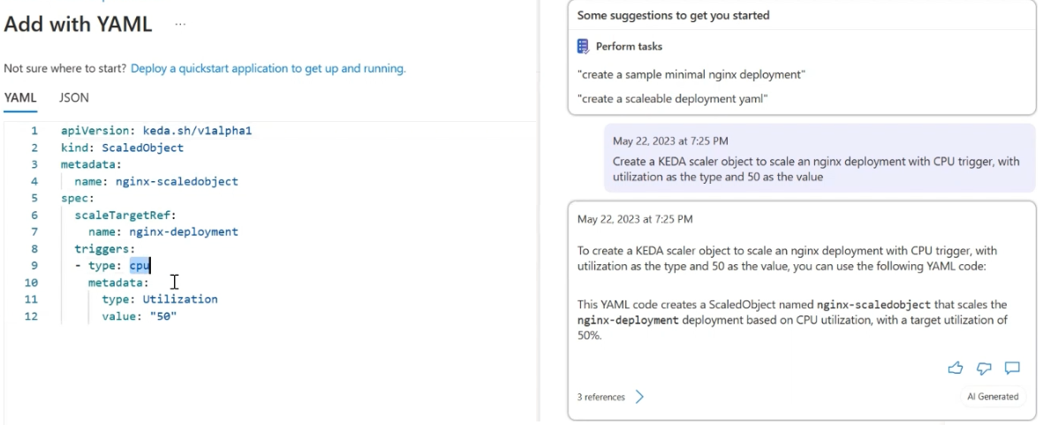
Samples 1 - Blueprint

Slide 10
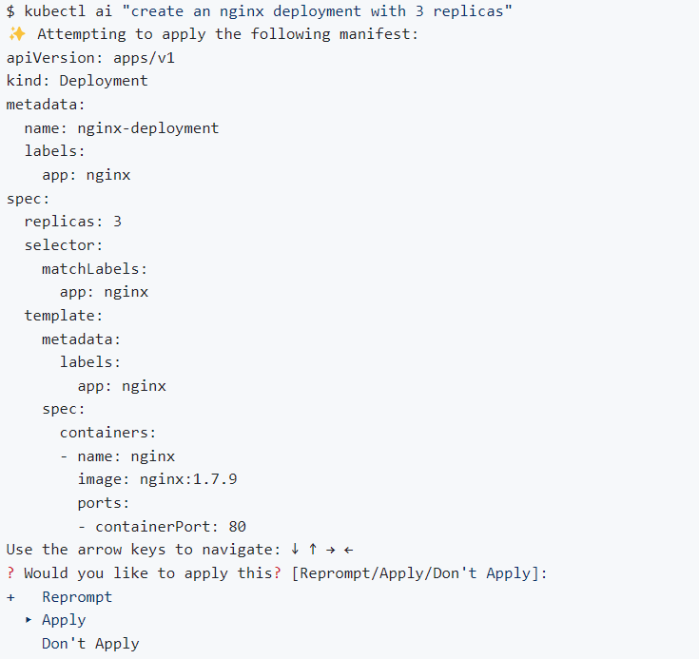
Samples 2 - Blueprint

Slide 11
Thank you!

